Slide 1
Investment and Investors Analysis
Sachin Gupta – PTDA_13_339
Rohit Gorle – PTDA_12_032

Slide 2
AGENDA
Introduction
Background
Prerequisites
​Objective
Dataset Description
Insights
Analysis Tasks
Presenting the final outcomes, Dashboard
​​Challenges & Learning

Slide 3
Introduction
Crunchbase is a platform for gaining awareness about business information about private and public companies. It provides intelligent prospecting software powered by live company data.
Their content includes investment, investors, and funding information, founding members and individuals in leadership positions, mergers and acquisitions, news, and industry trends.
Their software includes tools for investment analytics, trend analysis, web traffic review, and marketing.
They also carry news regarding startups.

Slide 4
Background
Crunchbase is a digital HQ for business information, from mergers and
acquisitions to seed rounds and investor details. Originally focused on tracking
and analyzing startup activity, the tech company now includes a variety of
prospecting, lead generation, and communication tools, all still driven by data.
Crunchbase has gathered interesting statistics like how much money the average successful startup raised ($41 million), sold for in an acquisition ($155.5 million), and exited at ($242.9 million).
Not only does Crunchbase’s information come from potentially biased sources, but it also covers only a fraction of the relevant details regarding a founder or investor’s background.

Slide 5
Prerequisites
Data Understanding
Data Manipulation
Data Analysis
Data Interpretation
Data Visualization
SQL
Excel

Slide 6
Objective
A Crunchbase Company wants to design a Crunchbase Investment and Investors dashboard to analyze the investors and their investments from the database.
The company wants to add user control for countries with the most investors, investors have investment partners, Type of funding round investors are investing, Distribution of investors between Organization and individual person, Regional Analysis of investors, and Monthly Analysis of investors and investments.
So, users can select an option and can see the investments year-wise.

Slide 7
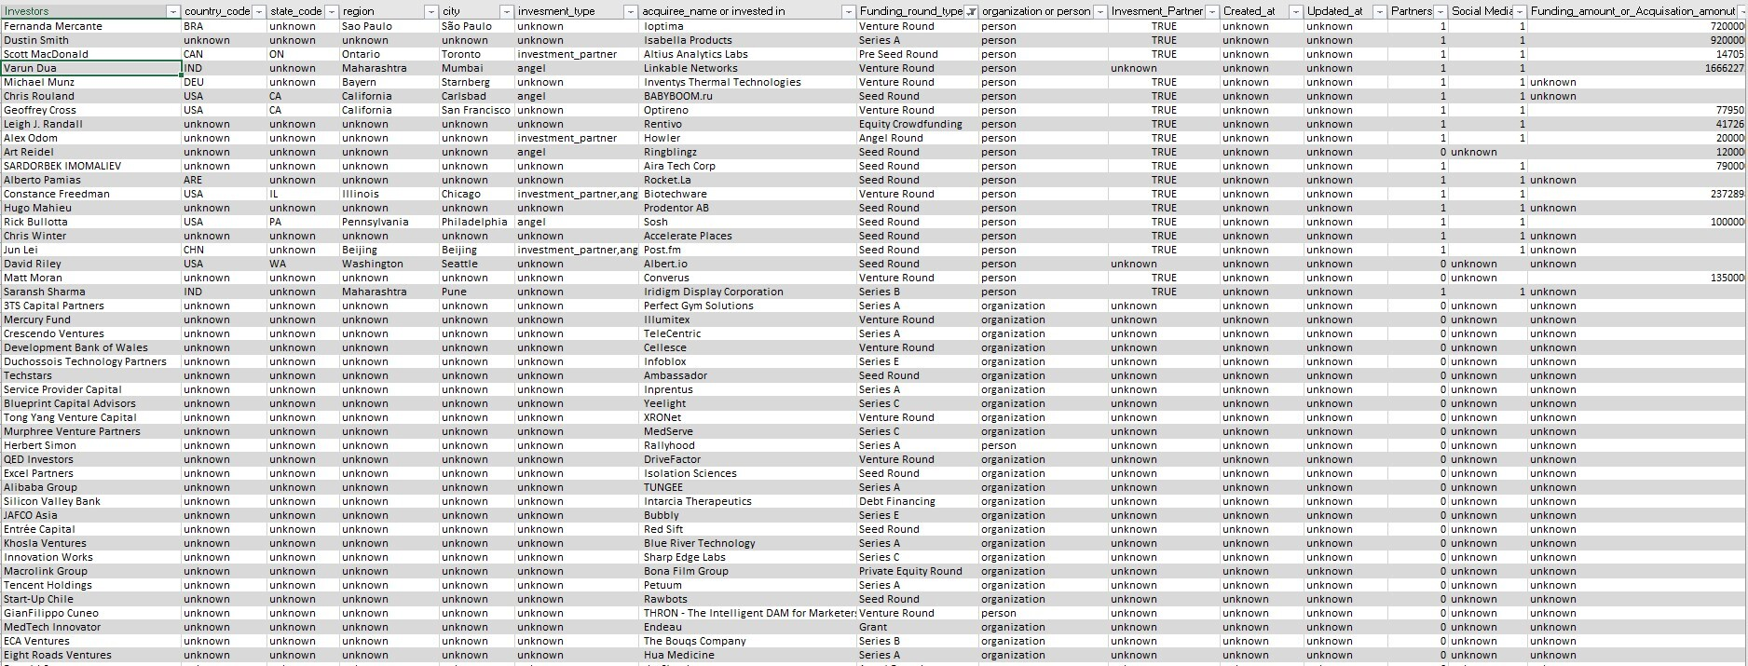
Data Description

Slide 8
Insights
Using SQL Server:
Importing Dataset from Excel to SQL Server.
Understand the Dataset
Started Finding key insights
Solving all insights by using SQL Query
Exporting Data To Excel
Using Excel
Create a Donut Chart to analyze the Top 2 most investors with Country Code.
Used KPI :
Findings count_of_investors with Investment Partners.
Total_funding_amount
No. of investors are using Social media
Not Using Social Media
Types of funding round investors are investing in
Distribution of investors between Organization and individual
Regional Analysis of investors
Monthly Analysis of investors and investments
Degree type Investors and Specialized Number of Investors
List of companies which got most invesments.
Top 10 investors by amount
Create a dashboard.

Slide 9
Analysis Tasks

Slide 10
SQL Query and Excel Visualizations

Slide 11
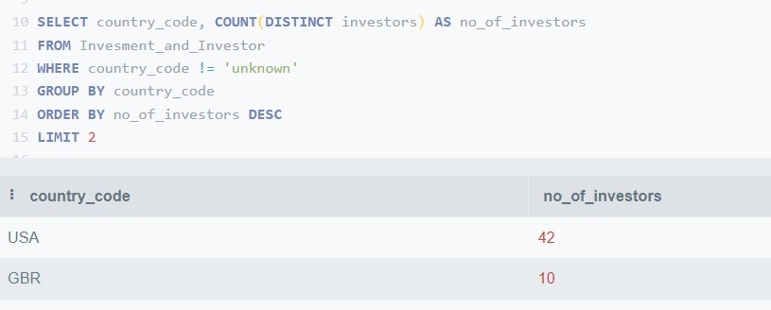
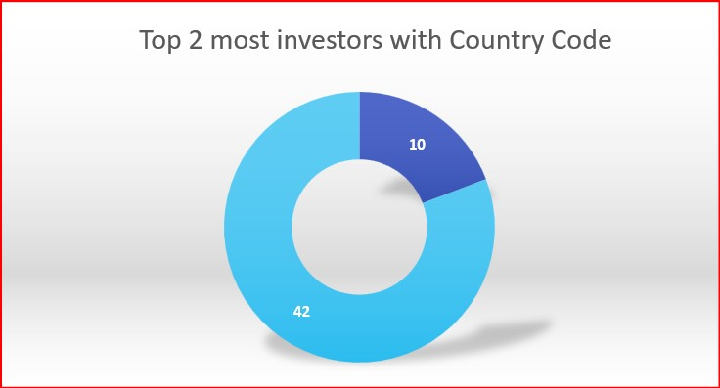
From which countries(Top 2) most investors are from?

Slide 12
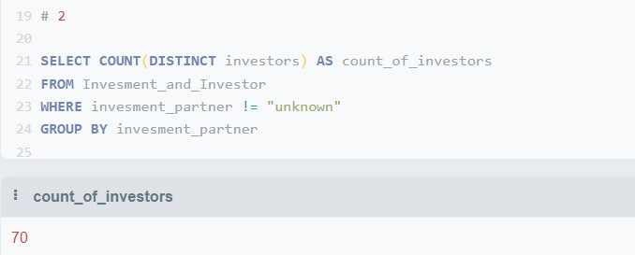
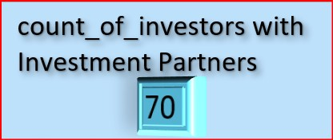
How many investors have investment partners?

Slide 13
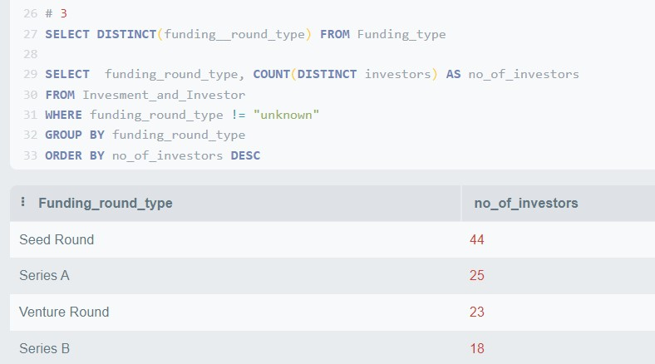
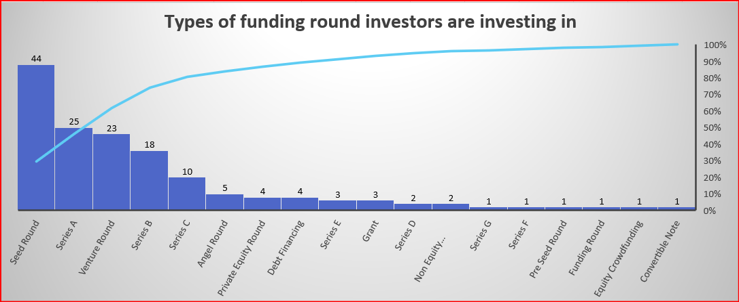
Type of funding round investors are investing in?

Slide 14
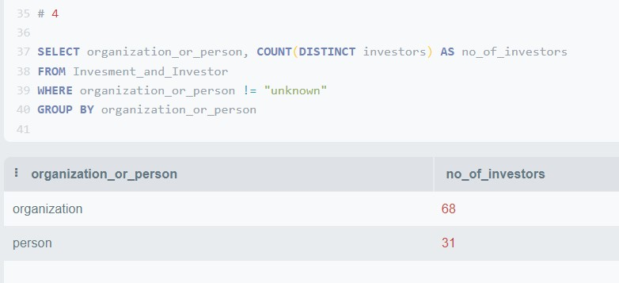
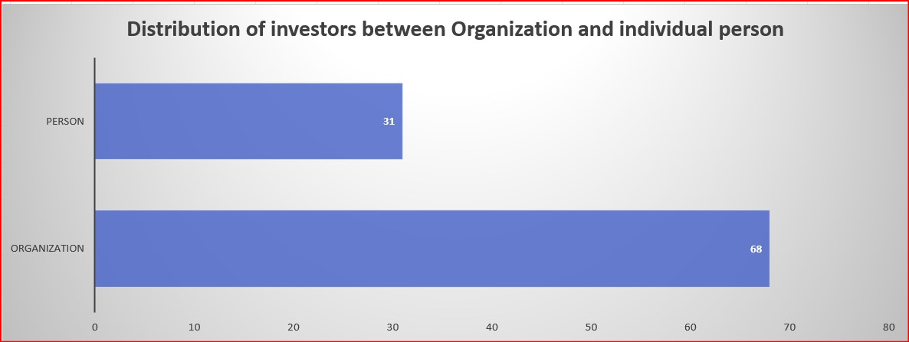
Distribution of investors between Organization and individual person

Slide 15
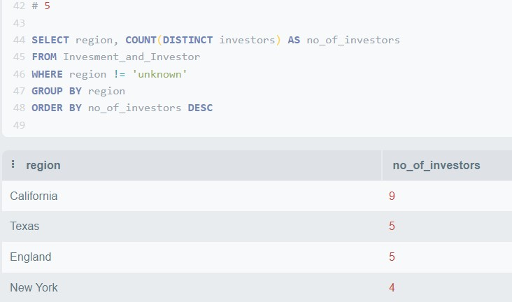
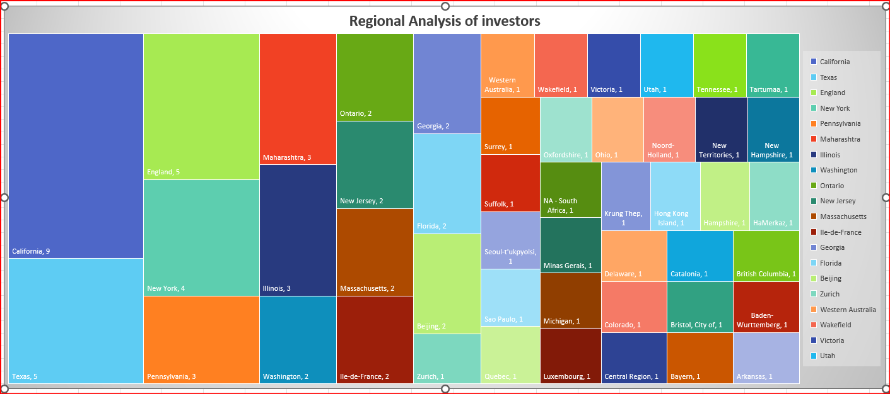
Regional Analysis of investors

Slide 16
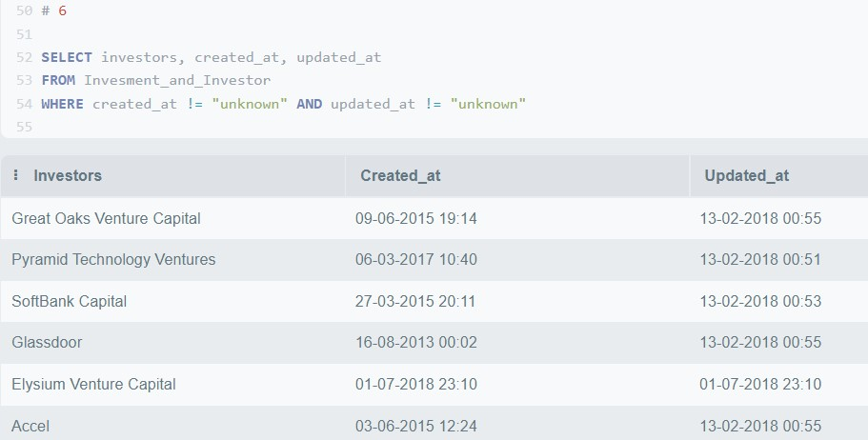
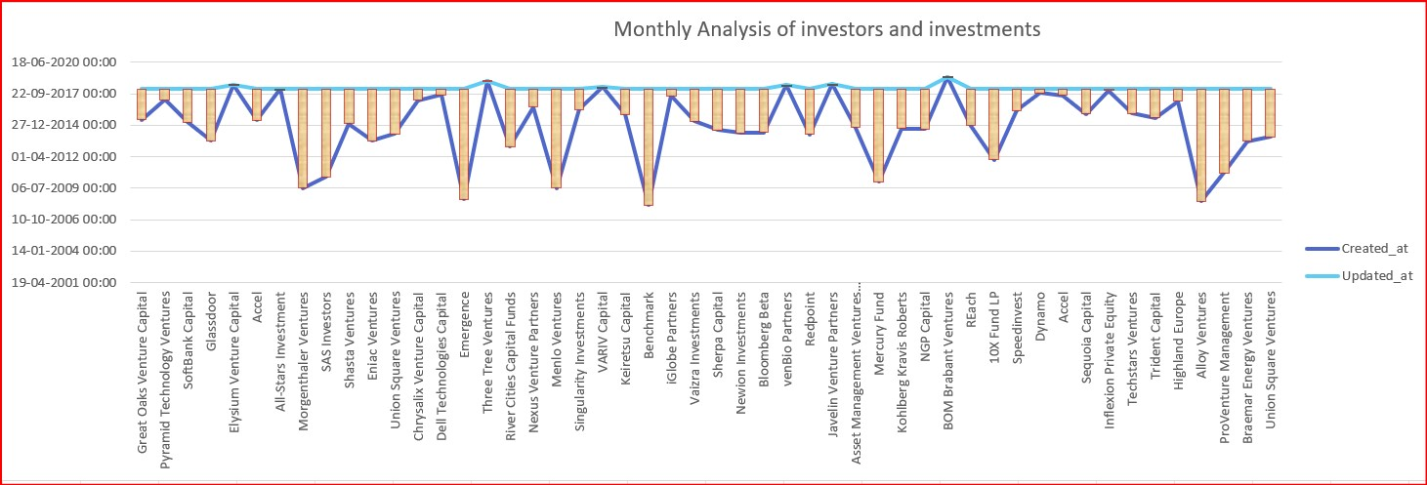
Monthly Analysis of investors and investments

Slide 17
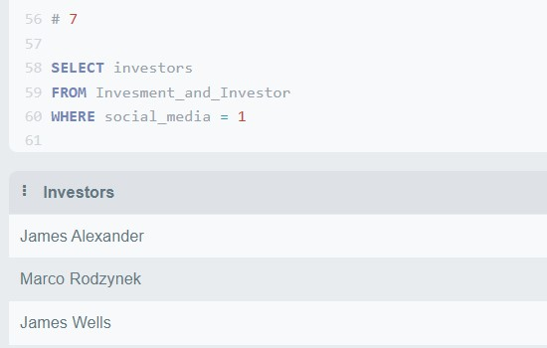
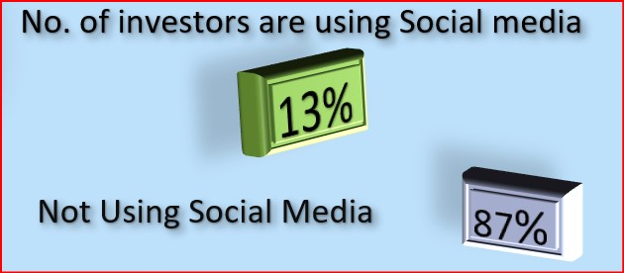
Analysis of social media presence of investors

Slide 18
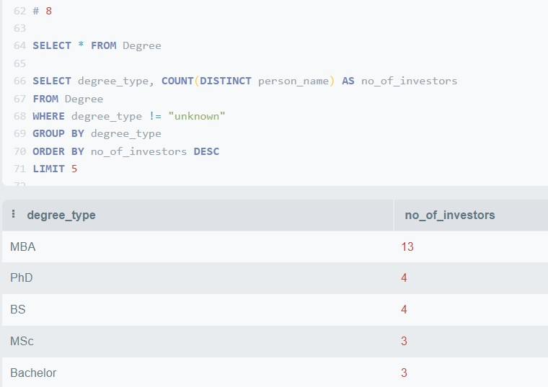
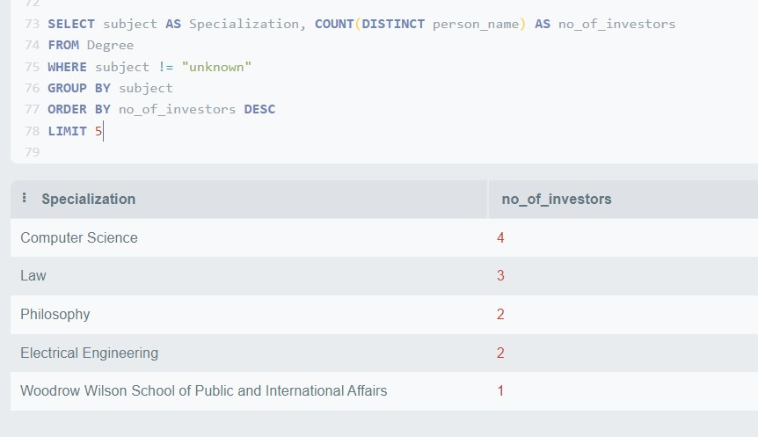
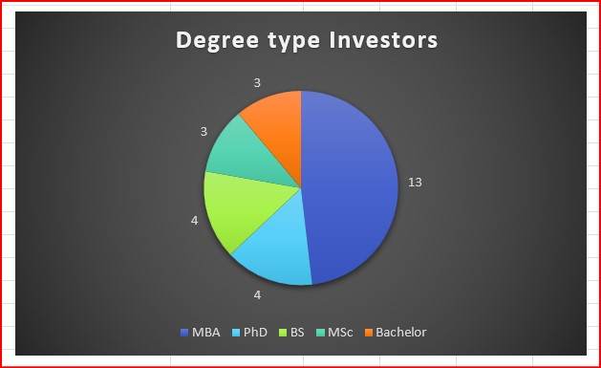
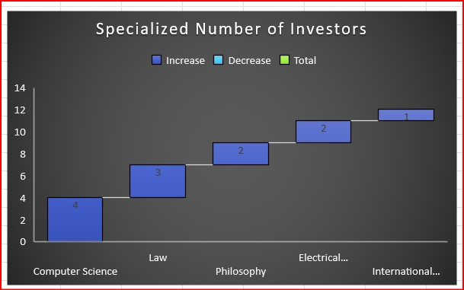
Qualification (Degree) and Institution Analysis of investors

Slide 19
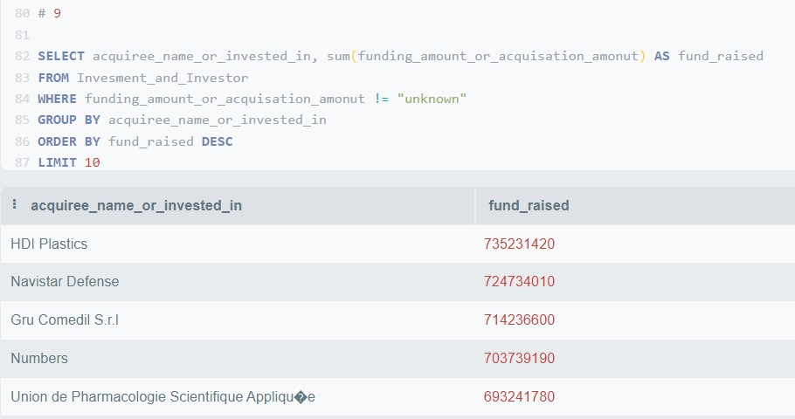
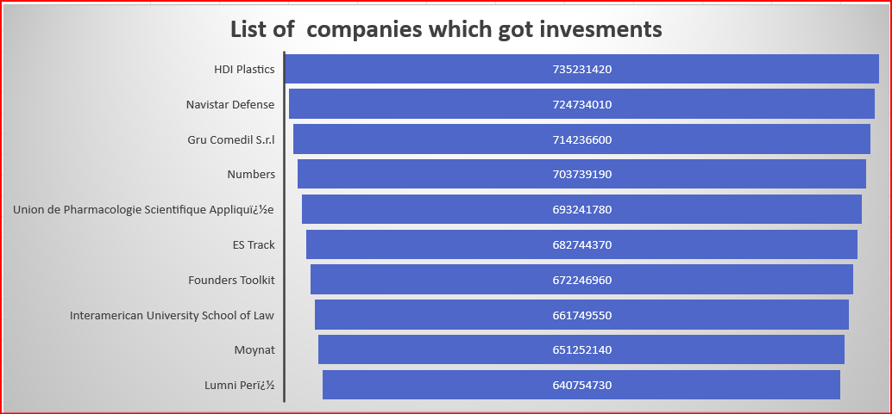
No of companies which got investments and their list

Slide 20
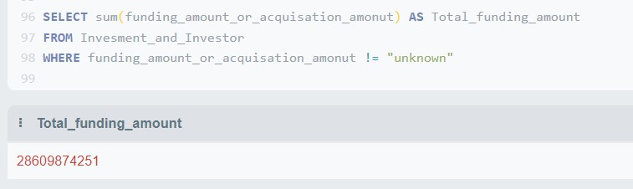
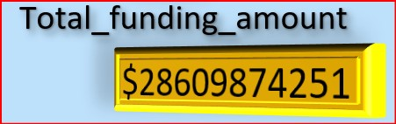
Total_funding_amount

Slide 21
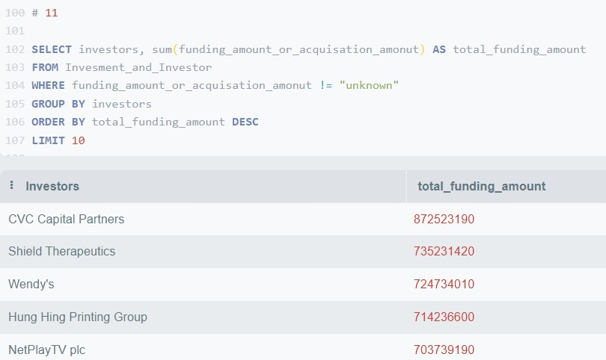
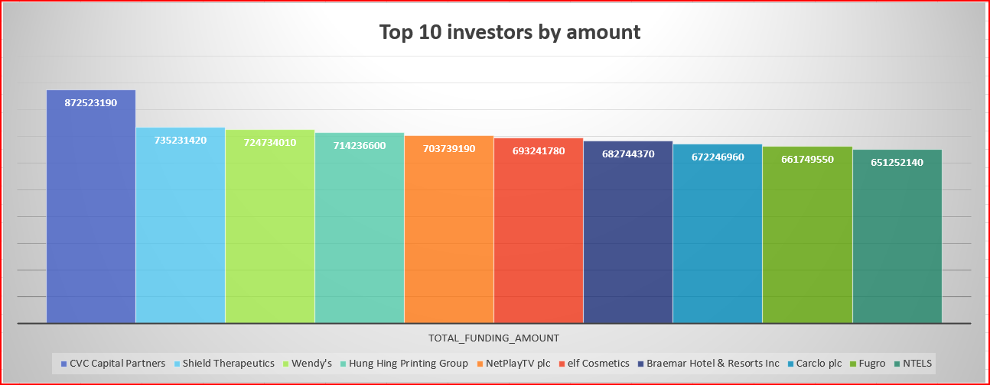
Top 10 investors by amount

Slide 22
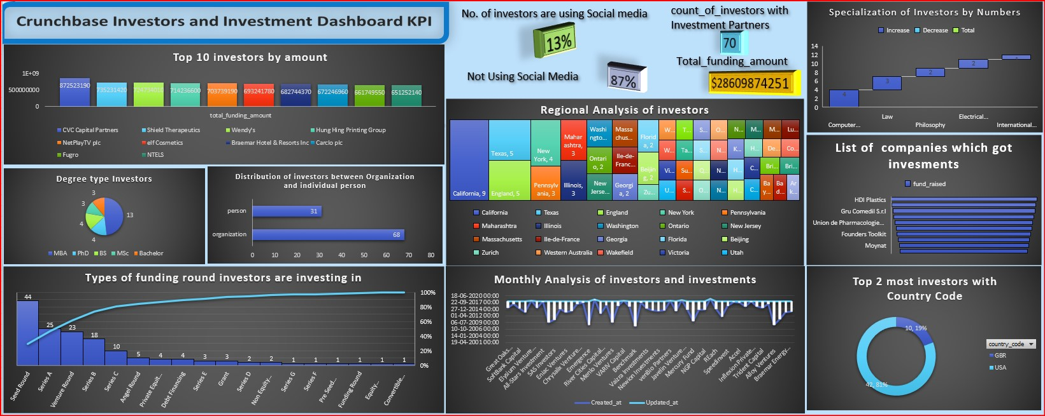
Dashboard

Slide 23
Challenges
The type of data was very unstructured.
Inaccessible database.
Data Interpretation because of complex database.
Difficulty in creating Joins because of less correlation of tables in the database.

Slide 24
Learnings & outcome
An exposure of working on industry related database Project for first Time.
Collecting meaningful data from the Database.
Visual representation of data.
The change to practice data analytics techniques on real-world data sets and to compile a project portfolio to show potential employers.

Slide 25
THANK YOU
sg07011998@gmail.com
rohitgorle33@gmail.com

